Slide 1
Florida Trade Flow Study
presented to
Florida Transportation Commission
presented by
Carrie Blanchard, Ph.D.,
Florida Chamber Foundation.
November 5, 2010

Slide 2


Florida’s Leaders Have Come Together
To Shape Florida’s Future
Florida Chamber Foundation
  Research organization and problem-solver, working in partnership with state business leaders to advance and fund activities in public policy research
Florida Department of Transportation
  Provides a safe transportation system that ensures the mobility of people and goods, enhances economic prosperity and preserves the quality of our environment and communities
Plum Creek
Lykes Brothers
Duda
Florida Ports Council
Florida Land Council
Florida Trucking Association
Enterprise Florida
CSX
Norfolk Southern
Notes:
Background slide as needed …
Introduce the Florida Chamber Foundation to groups that may not be familiar with the Foundation
Highlight the importance of the partnership between the Foundation and FDOT
Recognize the study partners

Slide 3
Florida Trade Flow Study Objectives
Document existing domestic and international
trade flows
Estimate future domestic and international trade flows
Identify opportunities for Florida to compete globally
Recommend strategies to pursue most attractive opportunities
3
Notes:
Review study objectives

Slide 4
Florida Trade Flow Study Activities
Overseen by Study Review Committee
Research led by national experts
  Cambridge Systematics, Inc.
  Martin Associates
Detailed database
  Domestic/international freight flows to, from, within Florida
  10, 25, 50 year forecasts
Economic impact models
Interviews with ~100 shippers, carriers, ports/terminals, economic developers
Notes:
Briefly highlight how the study was conducted
Large study review committee of public and private experts meet several times, reviewed all documents – included all transportation modes, economic development organizations, businesses, land owners etc.
Research led by national experts with extensive Florida experience (Cambridge Systematics, Martin Associates).
Most comprehensive database ever developed of freight flows to/from/within Florida – domestic and international trade, all modes; developing 10, 25, and 50 year forecasts
Economic impact models in common use by FL seaports, airports
Personal interviews with ~100 shippers, carriers, ports/terminals, distribution centers, economic developers, etc. to document logistics patterns and identify key issues

Slide 5
Why Focus on Trade?
U.S. Foreign Trade Value Expected to Quadruple by 2035
$25
Real Gross Domestic Product
$20
Real Value of Imports and Exports
$15
Trillion U. S. 2000 Dollars
$10
$5
1995
2000
2005
2010
2015
2020
2025
2030
2035
Source: Global Insight, Inc. April 2009.
5
Notes:
5
Why focus on trade as a driver of Florida’s economic recovery and future growth? Three reasons:
First, trade is expected to grow faster than the U.S. economy as a whole.
In 2005, the combined value of U.S. imports and exports was equivalent to 27 percent of the U.S. real GDP (i.e., GDP adjusted for inflation). Global Insight forecasts that the value of U.S. imports and exports will be equivalent to 60 percent of GDP in 2030.

Slide 6
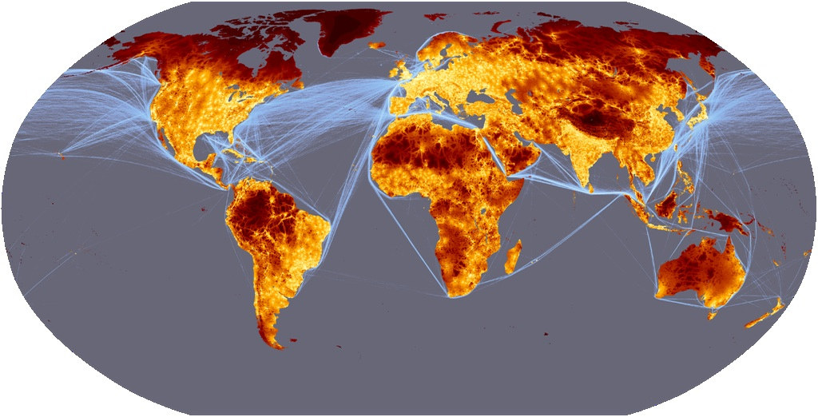
Why Focus on Trade?
Changing Global Trading Patterns Favor Florida
Source: European Communities, 2008
Notes:
Second, trade routes are changing and these changes favor Florida.
Graphic highlights major trade routes – over the past few decades, two major trade routes:
Between Europe and Eastern US across the Atlantic Ocean
Between East Asia (Japan, Korea, China) and Western US across the Pacific Ocean
Major changes anticipated over the next few decades
Panama Canal widening in 2014 – greater use of Panama Canal to bring Asian trade to Eastern US – estimates suggest 25% or more of Pacific trade will be diverted from Western US ports to Eastern US through Canal
As Asian production centers shift to South Asia (India, etc) – Suez Canal more direct route to Eastern US
North/south trade between Latin America and Caribbean and Eastern US will grow as Brazil and other nations experience strong economic growth (wild card: reopening of Cuba)
Africa may become more significant as well - -Florida is closest US state to Africa
All of these trends taken together place Florida in a very strategic position at intersection of multiple trade lanes

Slide 7
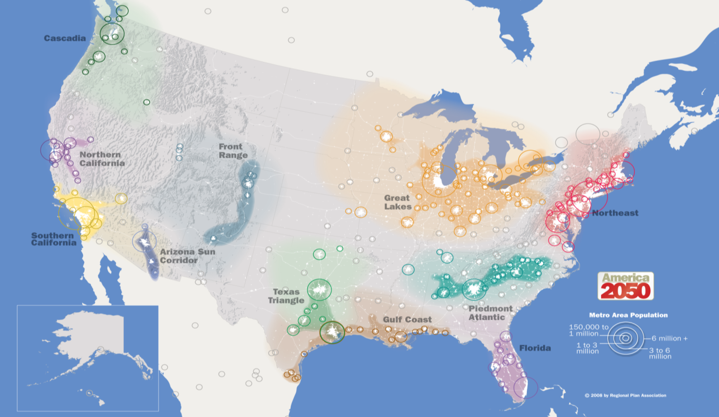
Why Focus on Trade?
Florida Located in Fastest Growing US Consumer Market
Source: America 2050, Regional Plan Association
7
Notes:
Third, Florida is in a strong position in the domestic US market.
Most forecasts suggest that over the next 50 years, the majority of US population growth will take place in the south and west – three states (CA, TX, FL) anticipated to account for ½ of all U.S. population growth; five states (those 3 + GA and NC) = 60%
The Florida peninsula is expected to be one of ~10 ‘megaregions’ dominating US economic growth through 2050 (one definition, by America 2050, is shown here)
Opportunity for Florida – combine its position in the fastest growing part of the US and its location on multiple trade lanes to drive growth in the next 50 years

Slide 8
Trade and Logistics in Florida Today
Key Source of Higher Wage Jobs
570,000 direct jobs in trade and logistics in 2008
Typical wage 29% higher than state average
Logistics Industry Percent of Total Employment
1998
2008
Florida
Source: U.S. Bureau of Economic Analysis, 2008
8
Notes:
Let’s take a look at some highlights of trade and logistics in Florida today.
This slides shows direct jobs in trade, logistics, distribution – people involved in moving, warehousing, and distributing goods (this does not include multipliers on these direct jobs)
570,000 direct jobs in 2008 – 7.4% of all jobs in the state, up from 7% in 1998 and about the same as the U.S. average.
Wages in these industries are about 29% higher than the state average. All jobs - $41,784; Logistics jobs - $53,970. Source: BEA (wages and salary per wage/salary employee) data for 2008.
GA and TX are examples of Southern states that have been even more successful than FL at growing logistics as part of their economy.
Logistics Industry Share of Total Jobs 1998 and 2008
1998 - 2008
Georgia
8.9% - 9.1%
Texas
8.4% - 8.4%

Slide 9
Trade and Logistics in Florida Today
Estimated Domestic & International Trade Flows, 2010
Source: Martin Associates, 2010 estimate based on TRANSEARCH, PIERS, and STB Rail Waybill data.
Notes:
Current estimate of total trade flows to/from/within Florida in 2010 – both domestic and international -- ~617 million tons
(Note if asked – this is different from some prior estimates in other studies – we have tried to eliminate doublecounting, for example goods that arrive on a ship and then switch to a truck)
All modes are important –
Trucking accounts for 73% of total tonnage – most goods use trucks for some portion of their trip
Water about 15%
Rail about 11%
Air about 1% by weight, but significantly higher by value

Slide 10
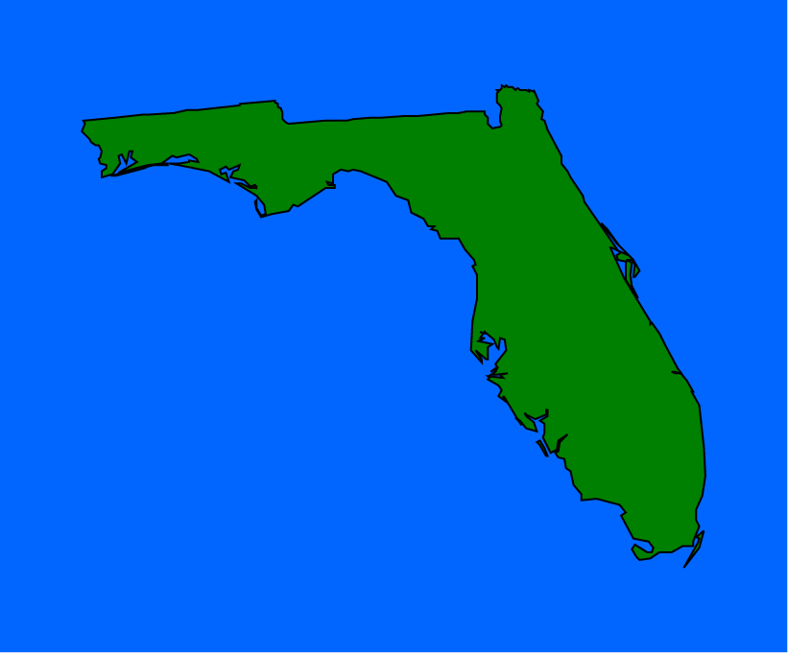
Trade and Logistics in Florida Today
Current Imbalance of Trade Flows
Exports
103 million tons
Imports
186 million tons
Within Florida
327 million tons
Source: Martin Associates, 2010 estimate based on TRANSEARCH, PIERS, and STB Rail Waybill data.
Notes:
10
Over ½ of Florida’s freight flows move within the state – originating and terminating in Florida
About 1/3 is inbound – moving from other states or nations to Florida
About 1/6 is outbound – moving from Florida to others sate or nations
Notice the large imbalance between inbound and outbound shipments -- a consequence of Florida’s large consuming population (residents and visitors) and relatively small manufacturing sector. This has important implications for how the freight industry operates, since many trucks and rail cars leave Florida empty. This also tends to increase costs for consumers
A Look Ahead: Long Range Trends in Florida January 27, 2009

Slide 11
Trade and Logistics in Florida Today
Florida Dominates Latin American/Caribbean Markets, but Has Room to Grow Elsewhere
Source: U.S. Census Bureau, U.S. Merchandise Trade Statistics, compiled by Enterprise Florida; shows share of trade based on value through Florida Customs Districts regardless of origin or ultimate destination
11
Notes:
One more key finding – Florida remains a national leader in trade with the Caribbean and Central and South America – accounting for 25-35% of all US trade value with these markets. But we have not enjoyed as much success with Canada, Mexico, Europe, or Asia, which traditionally have used other trade routes. One more reason we see opportunity for growth

Slide 12
Florida’s Future Trade Opportunities
Grow Florida origin exports
Maximize ability to serve supply chain for Florida businesses and consumers through Florida gateways
Expand Florida’s role as a trade gateway for the Eastern United States, the Caribbean, and Latin America
12
Notes:
The study examined many different trade opportunities for Florida, and identified three broad opportunities for the state, as shown here.

Slide 13
Opportunity 1: Grow Florida-Origin Exports
Billions
Goal: Double value of Florida-origin
exports within 5 years
Source: U.S. Bureau of Economic Analysis
Notes:
First opportunity – expand the value of exports originating in Florida – goods produced in Florida that are sold to markets worldwide.
Florida manufacturers, farms, mines and other businesses sold about $48B in goods worldwide in 2009. This represented about 6.5% of gross state product – about 1 percentage point below the U.S. average – so there is room to grow.
The Florida Chamber and Enterprise Florida have called for the state to double the value of international exports over the next 5 years. It’s a stretch goal, but it’s really just repeating the growth we experienced from 2003-2008.
We’re in the process of identifying which export categories are most likely to grow in the future –
One thing to keep in mind: if we double exports, that means a lot more trucks, rail cars, ships, and airplanes moving these goods to their final destination.

Slide 14
Opportunity 2: Maximize Ability to Serve Florida Businesses & Consumers
Containerized Imports – Today
Direct To Florida Ports of Entry
Direct to Florida through Ports
Intermodal Distribution to Florida
Conceptual Illustration Only
Notes:
Second opportunity – capture a larger percentage of trade serving Florida businesses through Florida’s own airports and seaports, rather than those in other states.
Preliminary findings
About 75% of FL origin exports of containerized goods use FL seaports to leave US; about 250,000 TEUs each year exit US through other states
TEU – twenty –foot equivalent unit -- standard unit for measuring containers
About 50% of waterborne containerized imports flow through Florida’s seaports – rest enter US through seaports in other states, such as Savannah, LA/Long Beach, etc.
Here’s how import flows work today
CLICK – blue arrows represent flow of incoming goods directly to Florida ports of entry
CLICK – green arrows represent flow of goods trucked directly to Florida after arriving in out-of-state ports (about 2.7 million tons per year)
CLICK – red arrows represented flow of incoming goods that are trucked to Florida from distribution centers in other states, especially Atlanta (about 8.8 millions tons per year)
Total gap -- 11 million tons per year of container imports are estimated to arrive in Florida from out of state seaports – so other states are reaping the benefits of handling this trade. This represents a key immediate opportunity to capture a larger share of import market for international containerized cargo consumed in Florida. 11 million tons =~2% of all freight flows in FL, about 12% of waterborne freight.

Slide 15
Opportunity 2: Maximize Ability to Serve Florida Businesses & Consumers
Containerized Imports – Future
Direct To Florida Ports of Entry
Direct to Florida through Ports
Intermodal Distribution to Florida
Conceptual Illustration Only
15
Notes:
Key is the Asian market -- ~1.2 million TEUs of Asian cargo flow through non Florida seaports; ~2.8 million TEUs including backhauls and empties – if we captured all of this, we’d essentially double container activity at Florida seaports
We’ve looked at detailed logistics costs for Asian containers destined for Florida. We examined three different port locations in North, Central and South Florida, and compared the total costs for these locations to the costs for moving containers arriving in Savannah and LA/Long Beach. In all cases, the Florida seaports provided a significant cost advantage on the total cost of delivery – with improvements of 8-27% over Savannah, and 34-45% over LA/Long Beach
So imagine our flows becoming like this.
CLICK – we’ll still see some incoming goods shipped to Florida through other ports, and
CLICK – some incoming goods shipped in to the state from distribution centers, but
CLICK – more goods flowing directly to Florida's own ports, for consumption in Florida
And as more goods flow directly to Florida, we may be able to reverse the flow and become a net gateway to the rest of the US, and a key location for sourcing the Southeast

Slide 16

Opportunity 3: Florida as a Global Hub
Air routes
Surface routes
Sea routes
Notes:
Third opportunity may be the most far reaching – how can we make Florida a truly global hub for trade?
We’ve already accomplished that in one area – Miami International Airport currently is the 12th largest air cargo hub worldwide
Can we do the same for seaports –for example, making Florida the first port of call for ships that pass through the Panama Canal with goods destined for the Eastern U.S.
Our current estimates that today, about ½ of the international waterborne trade that passes through Florida ports is not consumed or produced in the state – it is merely passing through.
So imagine if we increased that flow even more – and took advantage of being the port of entry (or exit) to also add value to the goods passing through

Slide 17
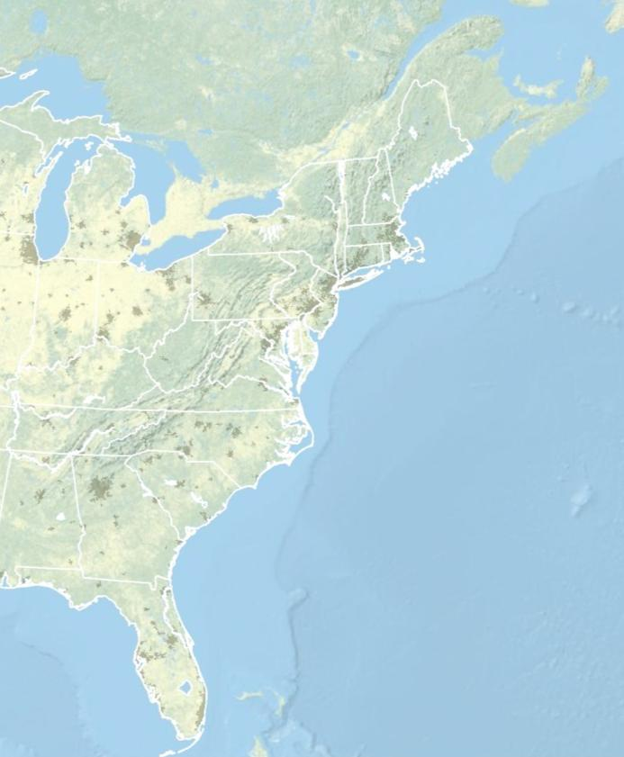
How Do We Get There?
Transportation Strategies
Capacity
  Expand seaport capacity; develop at least one first
  port of call (50 foot depth)
  Maintain MIA’s global role
  and develop additional air cargo capacity
Halifax
New York
Norfolk
Ports >48’ Depth
Existing
Savannah
c
Authorized
Jacksonville
Under Study
Everglades
Miami
17
Notes:
Let me spend a few minutes touching on some of the strategies being identified in this study
A big part of the solution lies in our transportation system
We do need to expand the capacity and improve the efficiency of our major trade gateways.
The projections we are looking at suggest we may need to double or more container throughput through our seaports, as one example. The seaport system as a whole needs to add capacity, but that does not mean every seaport needs to be able to handle the larger, post Panamax ships. But it is clear that we need at least one Florida port to have the 50 foot channel depth and larger facilities that can handle these ships and be a first port of call. As the map shows, only 2 East coast ports – Norfolk and Halifax – have 50 foot depth today. Miami and NY have been authorized to reach this level but need funding; Savannah, Jacksonville, and Port Everglades are actively studying this opportunity.
The 50 year projections also suggest we will need to expand our air lift capacity – to maintain Miami’s premier role and develop air cargo capacity in other parts of the state.

Slide 18
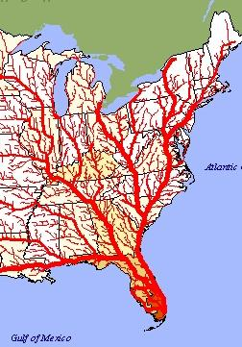
How Do We Get There?
Transportation Strategies
Connectivity
  Continue to improve
  intermodal connectors
  to seaports and airports (especially on-dock rail)
  Improve regional distribution networks
  Develop “marine highways”
  to other seaports
  Improve rail and truck corridors to Eastern U.S.
Source: Federal Highway Administration
18
Notes:
We also need to focus on connectivity - -at 3 major levels
Immediate connectivity to move goods to/from the airport/seaport property – for example, on dock rail at major seaports
More efficient regional distribution networks to bring imports from the gateways to distribution centers, businesses as efficiently as possible (and reverse for exports)
Better long distance connectivity via water, highway, and rail to other states
FDOT is already moving ahead on incorporating many of these concepts into its statewide plans including the 2060 FTP and the rail and seaport plans – so you’ll hear more about that later this morning

Slide 19
How Do We Get There?
It’s Also About Economic Competitiveness
Growth Leadership
  Develop international distribution centers close to major gateways
  Identify sites for industrial and logistics centers
Economic Development
  Identify global logistics
  as statewide targeted industry
  Target incentives, assistance to key industry clusters
Talent Supply and Education
  Expand global logistics workforce capacity
  Develop and retain skilled workers in distribution, manufacturing
Business Climate and Competitiveness
  Match national security standards
Quality of Life
  Reduce impact of freight on communities, environment
19
Source: Info USA
Notes:
But we recognize that our trade opportunities will require more than better transportation –
This slide highlights some of the other preliminary strategies identified by our study review committee (highlight a few)

Slide 20
Civic and Governance Systems
Need Different Planning Approach for Trade
Private Sector
Global
National
Region/Megaregion
Local
Public Sector
Notes:
One of the key issues is governance – something that is addressed in the draft FTP.
In Florida, as in other states, we’ve trended ot make transportation, economic development, and other planning decisions as the local level, by individual cities and counties that are closest to specific transportation problems and opportunities.
This approach is important for many reasons, but we must recognize that it is the complete opposite of how the private sector thinks. Major employers and shippers in Florida -- in particular, those that sell their goods and services outside of the state and bring income into our economy -- tend to view their Florida offices and factories at just one link in an increasingly national and global supply chain and distribution network. We need to start bridging this gap, by strengthening planning at the regional and megaregional levels.

Slide 21
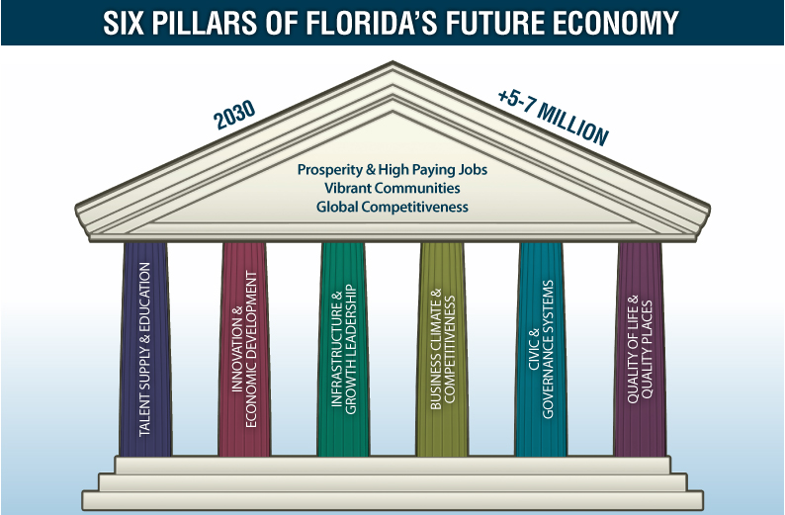
Notes:
Mention tie to the 6 pillars

Slide 22
What’s Next?
Complete alternative forecasts
Estimate economic impacts
Publish final report
Huddle Working Group
Incorporate into
  6 caucuses, Cornerstone 2030
  2060 Florida Transportation Plan
  Other statewide initiatives
Notes:
Next steps

Slide 23
Contact Information
For additional information, please contact:
  Carrie Blanchard, Florida Chamber Foundation
  cblanchard@flfoundation.org or 850-521-1283
  John Kaliski, Cambridge Systematics, Inc.
  jkaliski@camsys.com or 617-354-0167
23
Notes:
For more information
(can list Kaliski if needed for technical questions, or route everything through you)

