Slide 1
Florida Transportation Commission FY 2009
Miami-Dade Expressway Authority
Javier Rodriguez, P.E.
Executive Director

Slide 2
MDX Work Program FY 2011-2015 TIP
Goals
Advancing Long-Range Projects
“It’s a GO” for Open Road Tolling
ITS Next Steps
Completing Capacity Improvements
Partnering
FTC

Slide 3
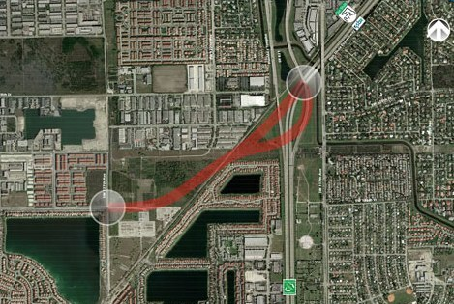
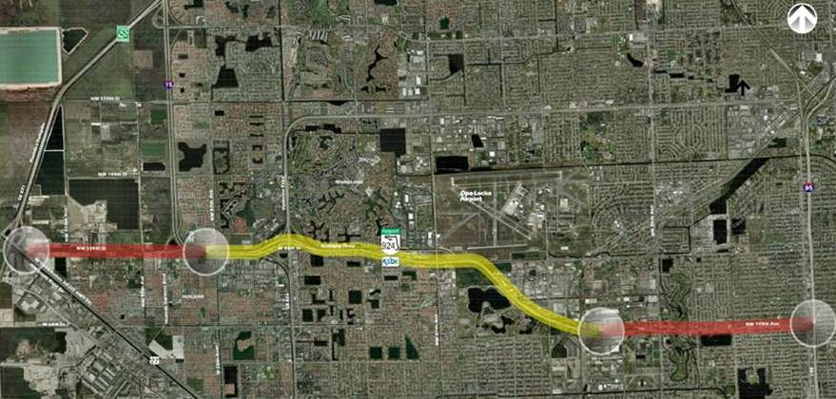
Advancing Long-Range Projects
SR 874 Ramp Connector
SR 924 Extension West to HEFT
SR 924 Extension East to I-95
U.S. 1 Express Lanes
Connect 4 Xpress
SR 836 Southwest Extension
Notes:
This work program funds 6 Project Development & Environmental studies. PD&E’s as they are known are planning phase studies that look at the environmental impacts and any necessary mitigation plan of a proposed project, alternative alignments and they include public involvement element to engage the public with their input and concerns. These PD&E’s are
SR 874 Ramp Connector – the contract for the project was awarded in Dec. 2009 and Kick off meeting with Agencies and the Public is scheduled for April 6. (You can obtain information from our calendar in our website. The adjacent public will be notified by direct mailing. ) We anticipate this study to be completed within 18 to 24 months.
SR 924 Extension West to the HEFT – The contract for this project was also awarded in Dec. 2009 and the Kick Off Meeting with the agencies and the public is also expected to take place in April.
SR 924 Extension East to I-95 – Anticipated startup by Spring of 2010 - the first public meeting for this project is anticipated to occur this summer.
U.S. 1 Managed Lanes – This PD&E’s startup is scheduled in Summer/Fall of 2010. Presently we are in the process of preliminary outreach efforts to gather public opinion in preparation for the of study.
Connect 4 Xpress - PD&E Anticipated start up in Summer/Fall 2010 –
SR 836 Southwest Extension – is not anticipated to commence until the FY of 2011

Slide 4
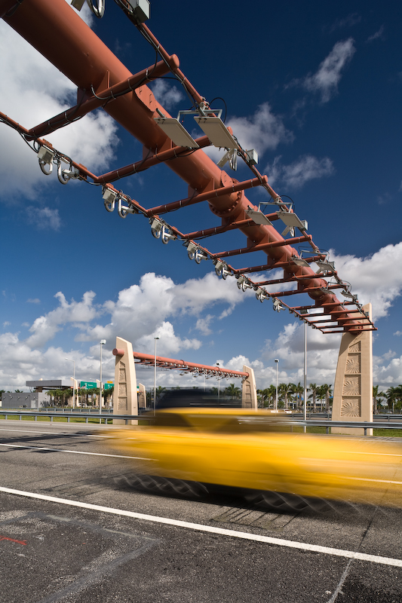
“It’s a GO” for Open Road Tolling
SR 924, SR 874 and SR 878 Infrastructure Modifications for ORT
Includes toll plaza removal (where existing), installation of gantries, shelters and signage
Under construction
Tentative Opening Dates
SR 924 – Spring of 2010
SR 874 / SR 878 – Summer of 2010
SR 112 – FY 2012
SR 836 – FY 2014 (w/ potential of being advanced)
Launched micro-site for ORT
www.mdxort.com
Notes:
This Summer MDX will be converting its expressways to Open Road Tolling. Modifications, which are underway, include removal of all existing toll plazas, the installation of signage, gantries and shelter which house the electrical equipment.
Tentatively the opening dates for ORT are:
Spring of 2010 for SR 924
Summer of 2010 for SR 874 & SR 878
SR 112 would convert in 2012
SR 836 would be converted in 2014 (there is a potential that SR 836 can be advanced to an earlier date.)
For more information on ORT and its benefits please visit MDXORT.com

Slide 5
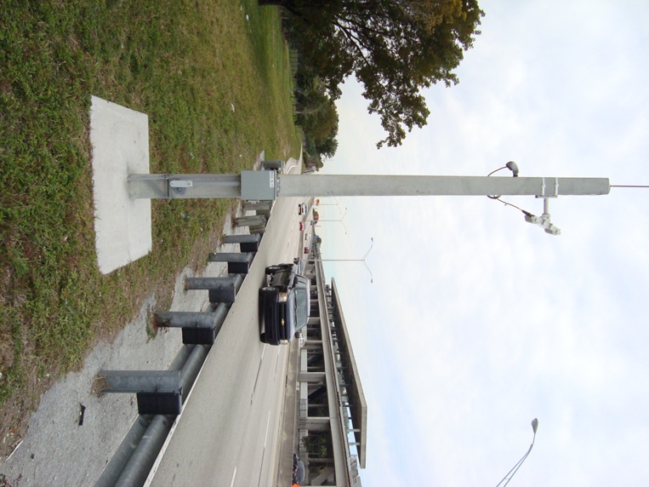
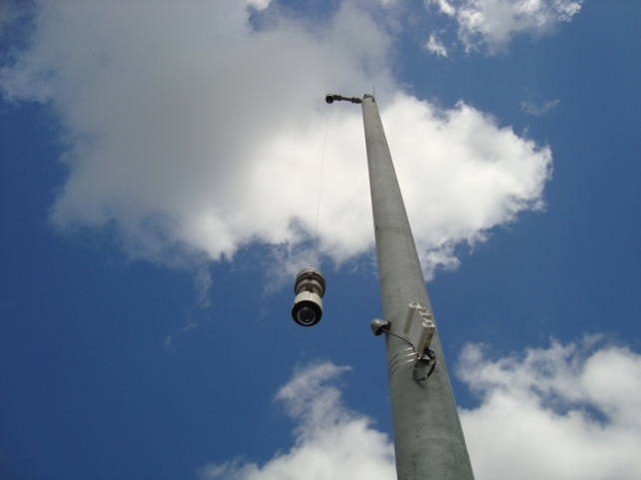
ITS – Next Steps
Systemwide Communications & Incident Management/Surveillance Completed in Feb. 2010
Next Steps….
Systemwide Implementation of Dynamic Message Signs
ITS Master Plan
Notes:
Collecting information on volume and occupancy on the MDX System
Next Steps …
Provide live traffic condition information to users traveling the System
Develop potential new projects related to the application of existing and new ITS technology to improve operations, information dissemination and mobility

Slide 6
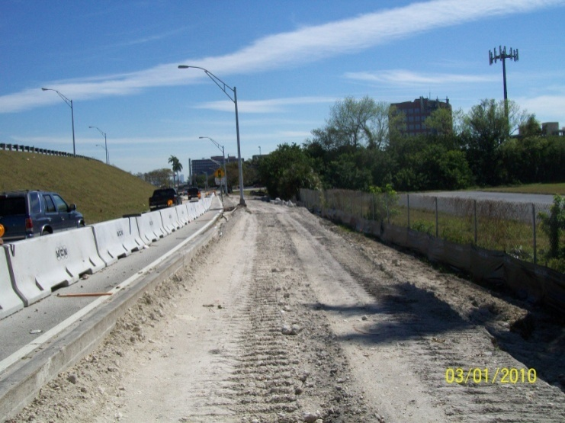
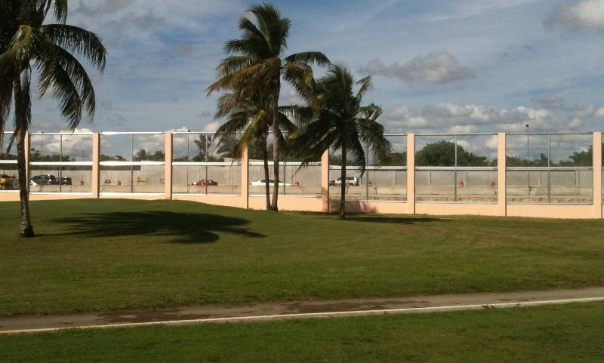
Completing Capacity Projects
SR 836 Eastbound Auxiliary Lane
SR 874 / Killian Parkway Interchange Improvements
SR 836 Interchange Modifications at 87th Ave.
SR 836 Auxiliary Lanes & Interchange Improvements (Eastbound NW 42nd Ave to NW 17th Ave and westbound NW 57th Ave to NW 27th Ave)
SR 874 Mainline Reconstruction
Notes:
SR 836 Eastbound Auxiliary Lane - Construction began in the Fall of 2009 and is anticipated to be completed in the Spring 2011.
SR 874 / Killian Parkway Interchange Improvements- Construction 35% complete- Sound Barrier walls along the project have been completed – the over all project is scheduled to be completed in Fall of 2011.
SR 836 Auxiliary Lanes & Interchange Improvements (EB 42nd to 17th Ave and WB 57th to 27th Ave) –
SR 836 Interchange Modifications at 87th Ave. -This project complements the planned SR 826/SR 836 Interchange Improvements- Final design estimated start at end of 2010
SR 874 Mainline Reconstruction- Final design plans 40% complete

Slide 7
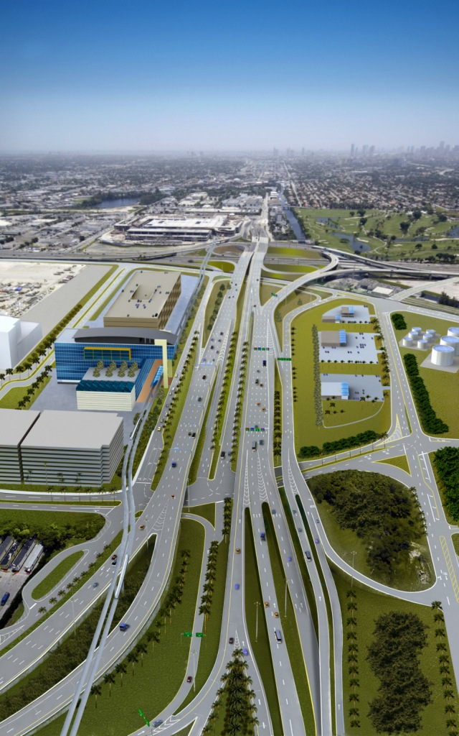
Partnering
Central Boulevard Reconstruction
MDX will act as a fund partner and grant recipient from FDOT to administer the project on behalf of MDAD
MDX/FDOT contributing up to $48.5 Million each
Design-Build Start – Spring 2010
SR 826 / SR 836 Interchange Improvements
Joint Participation Agreement with FDOT
MDX contributing $200 Million
Began in the Fall 2009
SR 874 / SR 826 Interchange Improvements
Joint Participation Agreement with FDOT
MDX contributing $60 Million
Construction began in Fall 2008

Slide 8
FTC Criteria Reporting

Slide 9
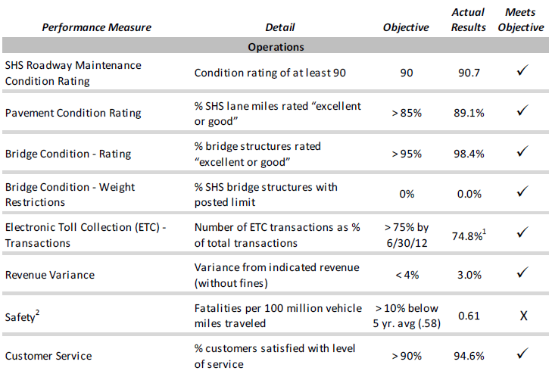

Slide 10
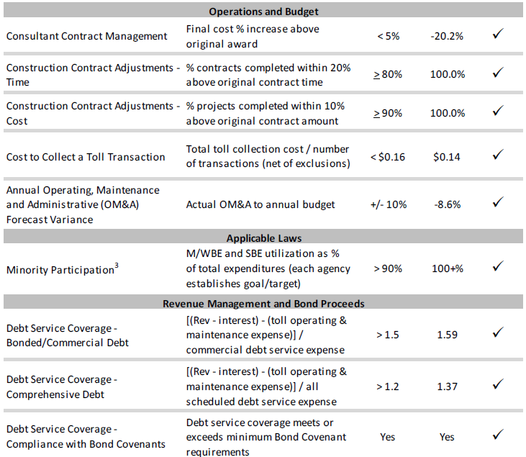

Slide 11
FTC Criteria:
MDX has met 16 of 17 Measures
Staff Reports measures to MDX Governing Board
FTC Criteria Enhancements – Maintenance
MDX’s Program on Traffic Safety

Slide 12
FTC Criteria Enhancements - Roadway Maintenance
In addition to the FDOT Mainline MRP, a custom MDX MRP is perform 3 times a year. The MDX MRP includes:
Ramps
Bridges
Monetary disincentives are issued to our Asset Maintenance Firms when measures are not met.

Slide 13
Traffic Safety: MDX’s Program
Monitoring
High Crash Locations
Safety Reviews
Fatal Reviews
Field Reviews
Solutions
Implementation

Slide 14
MDX System Fatalities – 2006 - 2009

Slide 15
Florida Transportation Commission FY 2009
Miami-Dade Expressway Authority
Javier Rodriguez, P.E.
Executive Director

