Slide 1
Transit Challenges & Opportunities
Gary Huttmann, AICP
Executive Director
MetroPlan Orlando

Slide 2
MetroPlan Orlando Overview Top Transit Challenges Serving OIA

Slide 3
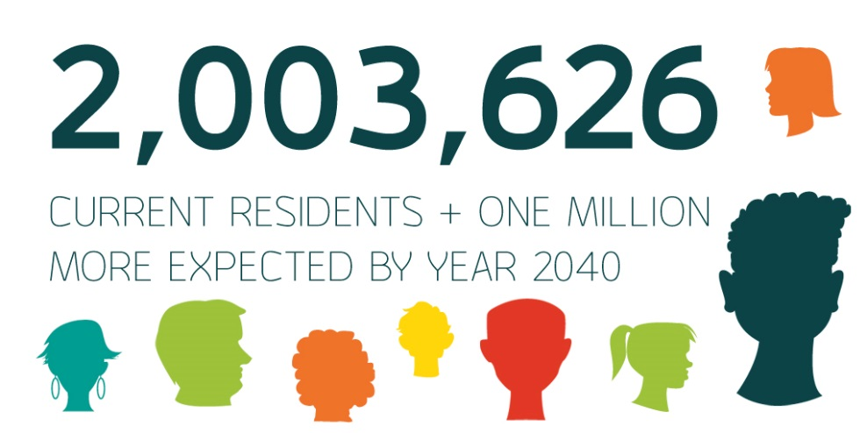
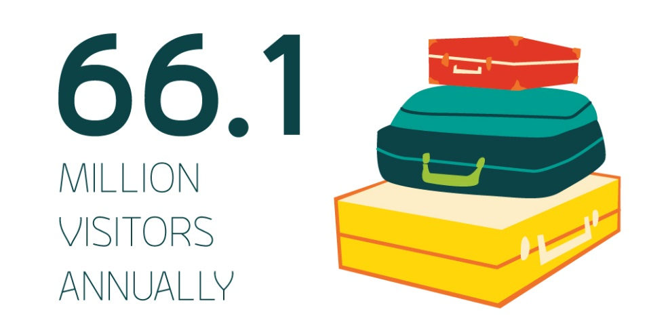
MetroPlan Orlando Overview
72

Slide 4
MetroPlan Orlando Overview
20-Member Governing Board
4 Advisory Committees
TIP = $600M-$1B per year
Central Florida MPO Alliance

Slide 5
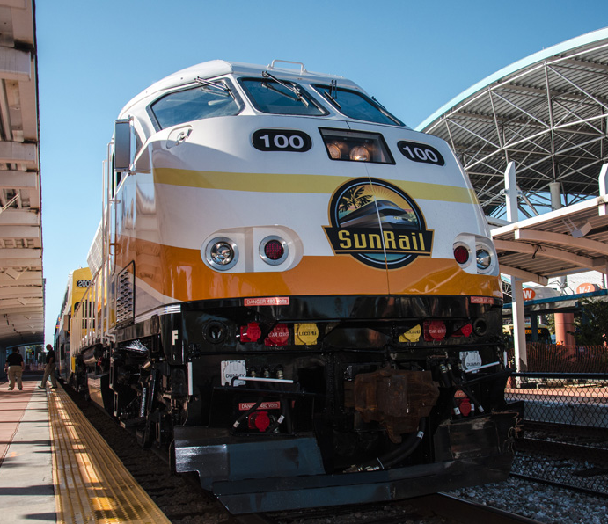
Top Challenges
SunRail
Phase II North
Connectivity
Phase III
Beyond Phase III
Transfer of responsibility in 2021
Putting more emphasis on transit solutions
Photo credit: SunRail/FDOT

Slide 6
2040 Financial Resources Funding the Plan

Slide 7
2040 LRTP Revenues 2019-2040
Table A-14
Agency | State/Federal | Local | Total
MetroPlan Orlando | $542 M | n/a | $542 M
SIS | $1,986 M | n/a | $1,986 M
SunRail | $338 M | $460 M | $798 M
LYNX | $1,117 M | $1,461 M | $2,578 M
Orange County | $1,006 M | $1,967 M | $2,973 M
Osceola County | $249 M | $4,549 M | $4,798 M
Seminole County | $337 M | $787 M | $1,124 M
City of Orlando | n/a | $250 M | $250 M
Trans. Alternatives | $53 M | n/a | $53 M
TOTAL | $5.6 BILLION | $9.5 BILLION | $15.1 BILLION

Slide 8
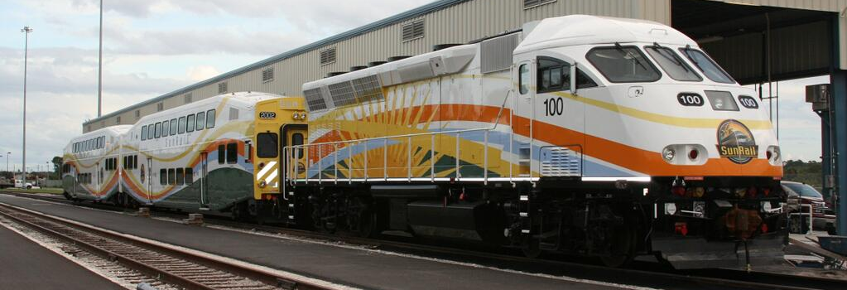
Transit

Slide 9
Transit Funding Plan 2019 - 2040
Agency | State/Federal | Local | Total
MetroPlan Orlando | $165 M | n/a | $165 M
SunRail | $338 M | $460 M | $798 M
LYNX | $1,117 M | $1,461 M | $2,578 M
Orange County | n/a | $1,436 M | $1,436 M
Osceola County | n/a | $1,701 M | $1.701 M
Seminole County | n/a | $207 M | $207 M
City of Orlando | n/a | $192 M | $192 M
TOTAL | $1.6 BILLION | $5.5 BILLION | $7.1 BILLION

Slide 10
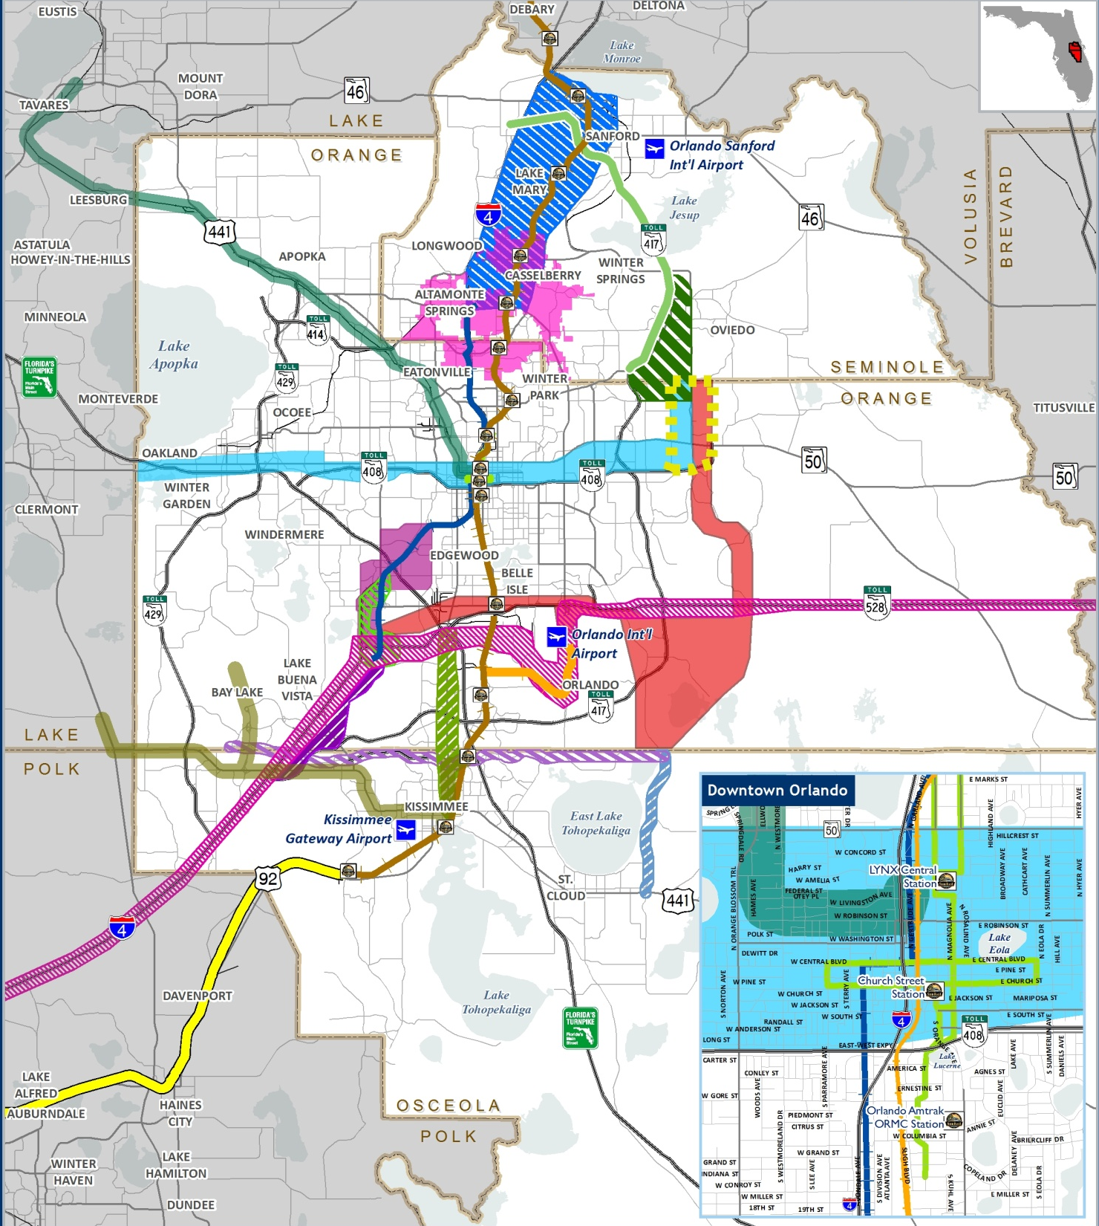
2040 Transit Blueprint
Identifying
and
Preserving
Transit Corridors

Slide 11
Cost Feasible Regional Transit Projects
SunRail Ph.1 & 2 (Deland to Poinciana)
Includes Feeder Bus Service
SunRail Ph. 3 (Meadow Woods Station to OIA)
LYMMO
N/S Extension (Orange)
E/W Extension (Grapefruit)
Parramore Extension (Lime)
OIA Refresh AA Corridor
US 192 Bus Rapid Transit
US 441 AA Corridor
Kissimmee Circulator
Improvements to LYNX existing system
Private Investment
All Aboard Florida
American Maglev

Slide 12
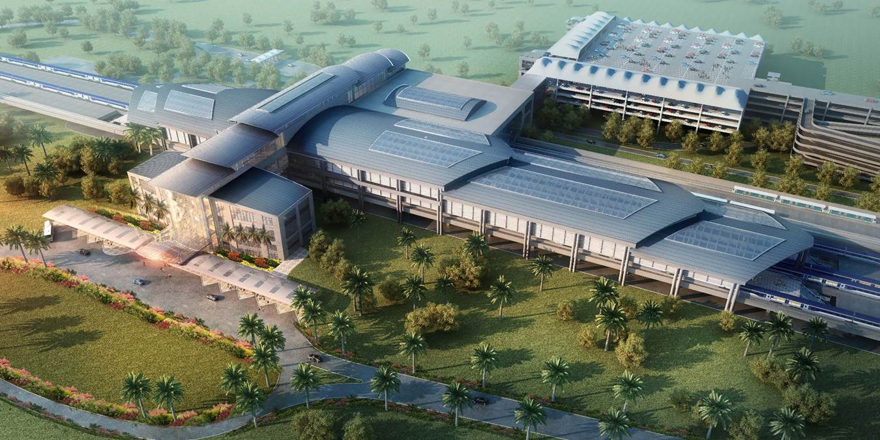
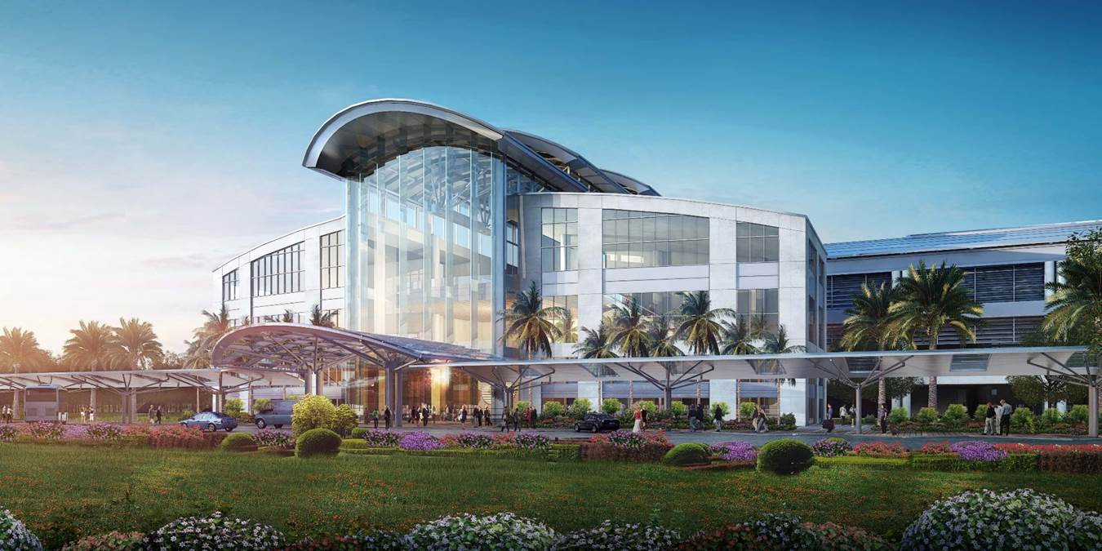
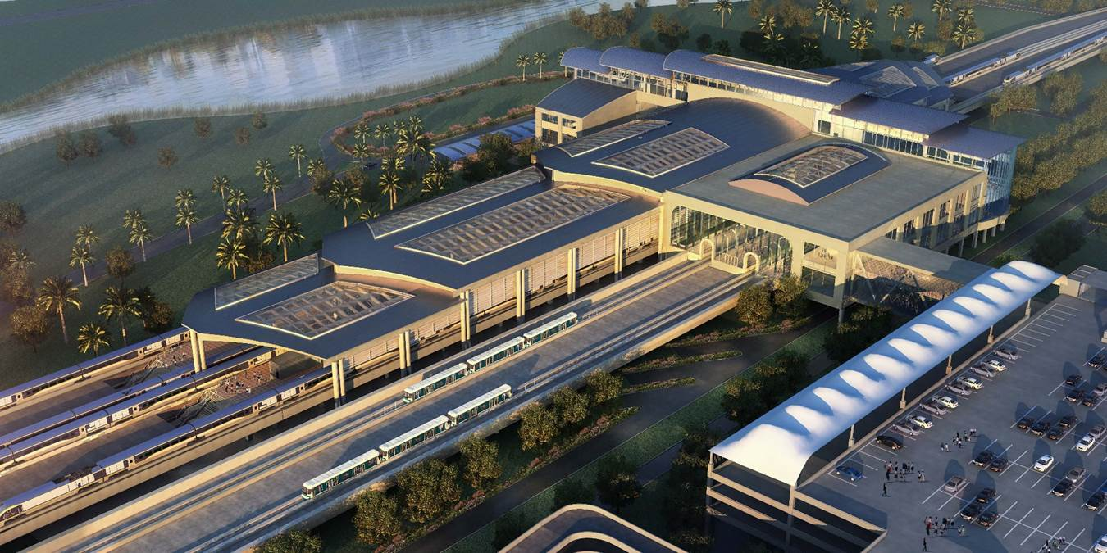
Orlando
International
Airport
Intermodal Transportation Facility

Slide 13
Why?
Major Regional Activity Center
New Intermodal Terminal
Federal, State Partners Value Connectivity
In Board-Approved Long Range Plan
Congressional Delegation Eager to Help

Slide 14
Automated People Mover at OIA Intermodal Terminal
COURTESY OF JOE BROOKS

Slide 15
Rail Platforms at OIA’s Intermodal Terminal
COURTESY OF GOAA

Slide 16
SunRail Phase 3 PD&E
Study Highlights
Completed 2016; finalized May 2018
Studied options using OUC spur
SunRail shuttle recommended
2,500 daily boardings (2020)
Capital cost of $257 million (2015)

Slide 17
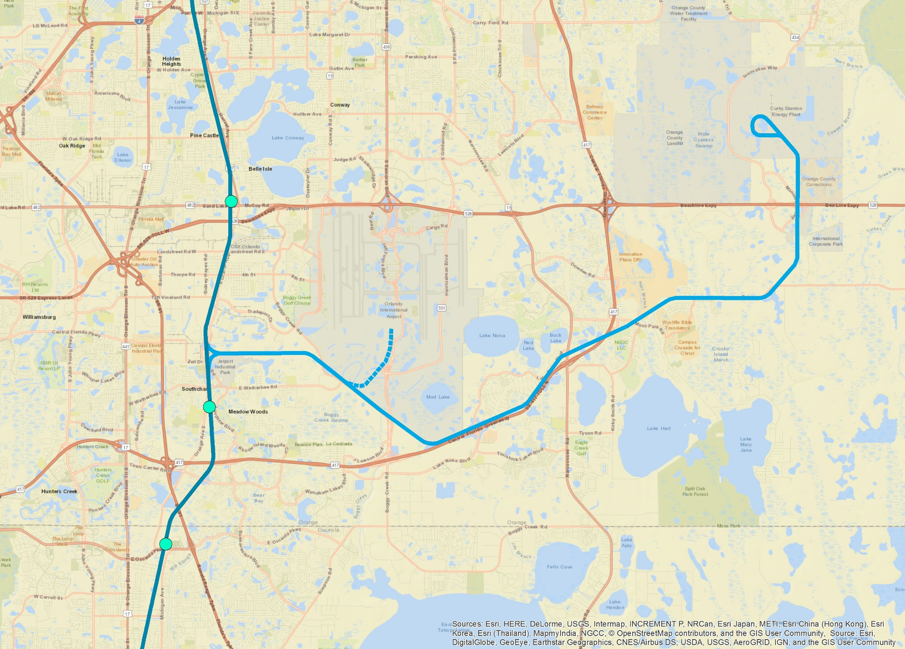
OUC -- Curtis Stanton
Energy Plant
Sand Lake Road
Station
Orlando
International
Airport
Intermodal
Center
Meadow Woods
Station
Osceola Parkway
Station

Slide 18
Considerations
Phase 2 North to DeLand
Current 61-mile Agreement
Overall Funding Picture
Convention Center/I-Drive District
Brightline Proposal; FDOT/CFX

Slide 19
Next Steps
Board Guidance Needed
Decision-Making Process
Research on Funding Agreements
Board Executive Committee Workshop
Develop Additional Cost Estimates

Slide 20
Thank You!
Questions/Comments

