Slide 1
Thoughts on Florida LRTPs
Dr. Adrian moore
Vice president
Reason

Slide 2
Causes of Road Congestion
In Orlando 2040 Plan, taken from FHWA

Slide 3
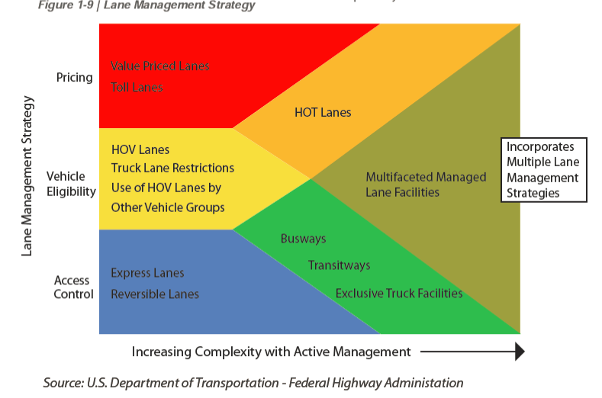
Complex Roads Are the Future

Slide 4
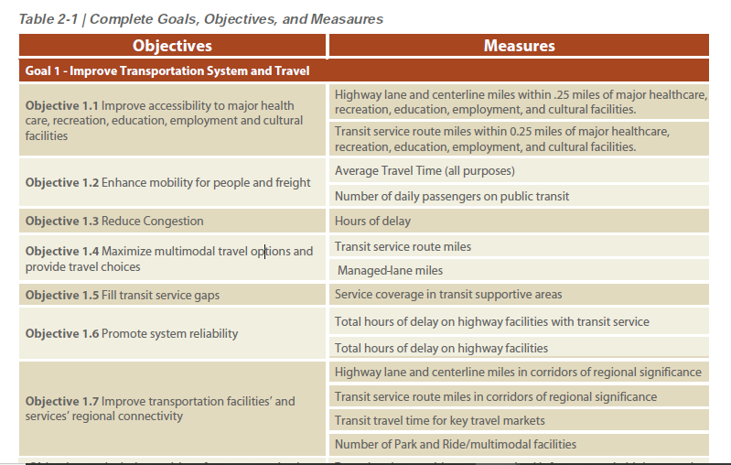
Performance Measures are Crucial

Slide 5
Relative Expenditures vs Relative Use
EXPENDITURES
Miami 2040 plan
35% for highway projects
65% for transit projects
Orlando 2040 plan
52% for highway projects
48% for transit projects
Hillsborough 2040 plan
47% for highway projects
53% for transit projects
FDOT Latest Mode Shares
Commuting by drive alone 79.2%
Carpool 9.2%
Transit 2.1%
Walk or bike 2.1%
Work at home 6%

Slide 6
Win-Win Ideas
Capacity is crucial
Done right BRT infrastructure can be used by Transit and Drivers.
Our 2012 study on Mobility in Southeast Florida proposed adding variably priced managed lanes to all of the region’s freeways, including toll roads.
This would add 1,117 lane-miles to 24 different limited access freeways.
Adding 14 managed arterial corridors, ranging in length from 2 to 25 miles where (LOS F) by 2030.
Modeling showed this would save 66,049,500 annual hours of delay or 47% of the current total delay. These savings total $1.004 billion for cars and $350 million for trucks.

Slide 7
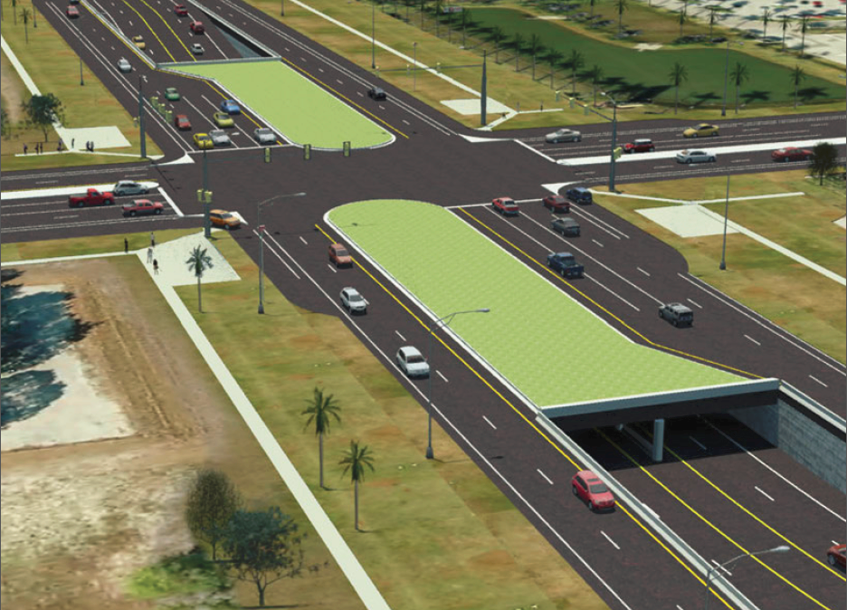
Managed Arterial Queue Ducker

Slide 8
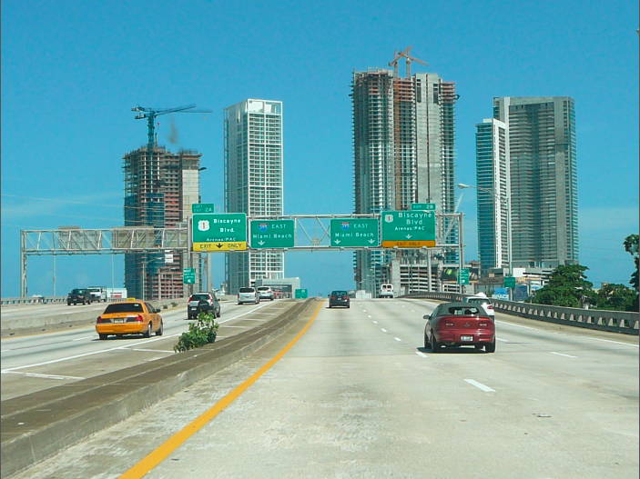
Bus Express Lanes
A combination of expanded bus service together with peak-period express lanes operation
will likely provide the best possible conditions for all drivers, including the majority of customers
who will continue to use the tollway’s general purpose lanes and pay traditional tolls.

Slide 9
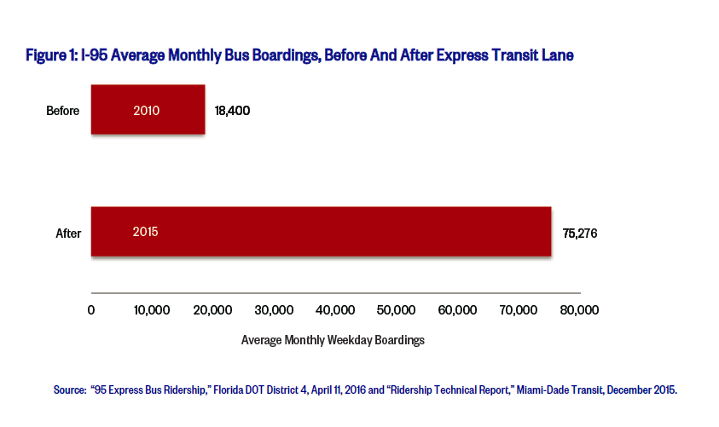
Express Transit lane, FDOT I-95 estimates

Slide 10
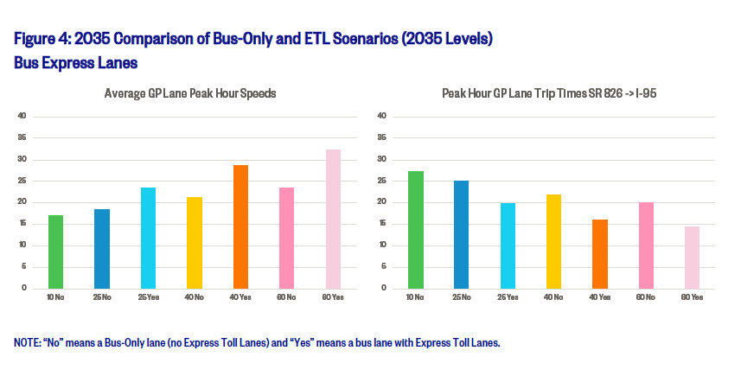
Bus Express Lanes vs Bus Only, SR 826

Slide 11
Thoughts for the Future
#1 Ridesharing
--A reality check on the infamous Schaller Study.
--Why do people chose ridesharing over transit?
#2 Automated Vehicles
--Its not about robot cars, yet.
--It is about incremental changes to vehicle tech that effectively ADD CAPACITY

Slide 12
Questions?
Notes:
There is a tension here.
--law enforcement!
--evolution of police role in justice system
--tension between dealing with criminals and protecting people vs. rights

Slide 13
?

