Slide 1
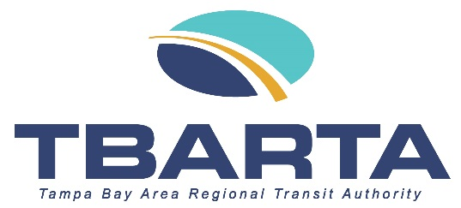
Regional Public Transit Challenges in Tampa Bay and TBARTA’s Evolving Role
Michael A. Case, Interim Executive Director

Slide 2
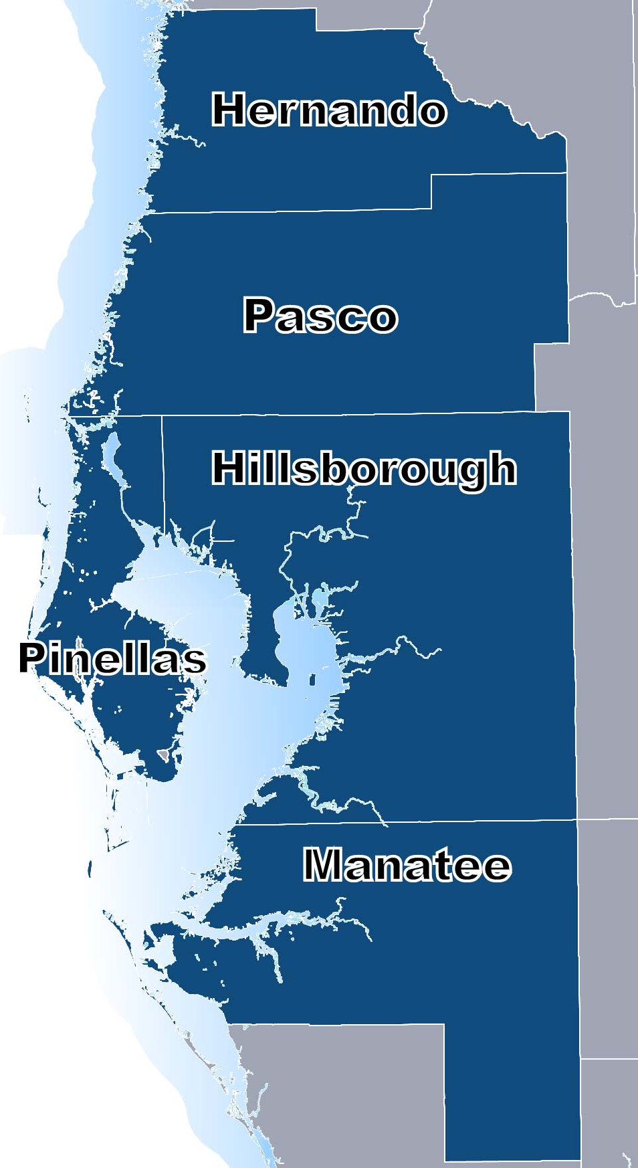
TBARTA 2017 Proposed Legislation
TBARTA
SB 1672 Effective July 1, 2017
NAME CHANGE:
Tampa Bay Area Regional Transit Authority
MEMBER COUNTIES:
Hernando, Hillsborough, Manatee, Pasco, & Pinellas
NEW REQUIREMENT:
Regional Transit Development Plan
Notes:
Examples of Regional Multi-Use Trails throughout the region include the Pinellas Trail, picture taken in Downtown Dunedin, the Legacy Trail, about 10 miles north-south in Sarasota County, and the Suncoast Trail, which you may have seen if you have ever ridden on the Suncoast Parkway through Pasco, Hernando, and Citrus Counties.

Slide 3

OTHER CHANGES
TBARTA Changes & Mandates
Recipient of Federal Funds supporting an intercounty project or an intra-county capital project
Rail Funding: Action regarding state funding of commuter rail, heavy rail, or light rail requires approval by majority vote of each MPO where rail transit investment will be made and the approval by an act of the Legislature
Notes:
Examples of Regional Multi-Use Trails throughout the region include the Pinellas Trail, picture taken in Downtown Dunedin, the Legacy Trail, about 10 miles north-south in Sarasota County, and the Suncoast Trail, which you may have seen if you have ever ridden on the Suncoast Parkway through Pasco, Hernando, and Citrus Counties.

Slide 4
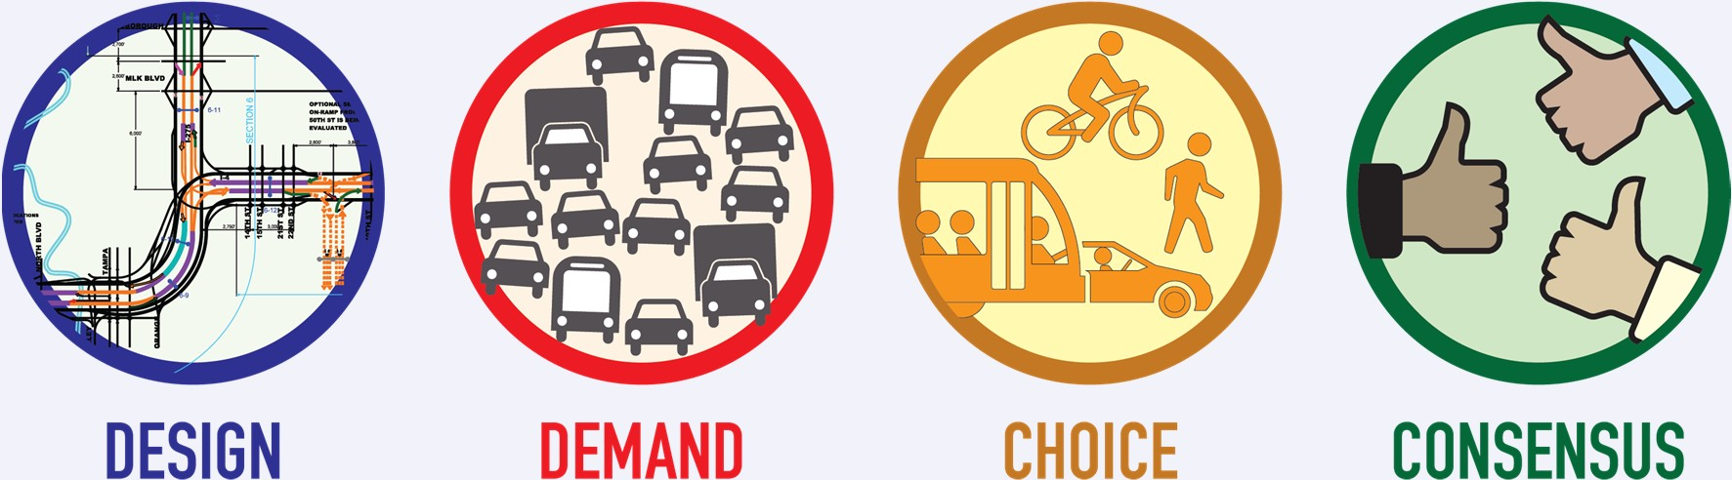
FOUR DISTINCT PROBLEMS FOR TRANSIT

Slide 5
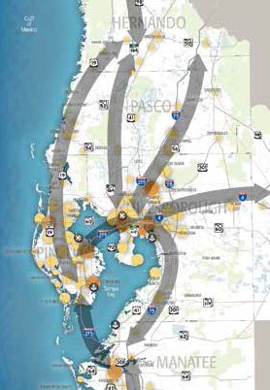
DEMAND: TRAVELING ACROSS COUNTY LINES FOR WORK (2010)
9% | or 3,272 Citrus County commuters
34% | or 19,497 Hernando County commuters
8% | or 43,471 Hillsborough County commuters
26% | or 33,219 Manatee County commuters
48% | or 83,140 Pasco County commuters
12% | or 50,562 Pinellas County commuters
7% | or 14,298 Polk County commuters
10% | or 13,086 Sarasota County commuters
+260,000
Source: 2010 US Census Journey to Work, County-to-County Trip Flows

Slide 6
DEMAND: TRAVELING ACROSS COUNTY LINES FOR WORK (2017)
18% | or 7,294 Citrus County commuters
45% | or 21,189 Hernando County commuters
18% | or 98,823 Hillsborough County commuters
39% | or 50,595 Manatee County commuters
54% | or 95,503 Pasco County commuters
21% | or 83,195 Pinellas County commuters
15% | or 37,583 Polk County commuters
21% | or 29,696 Sarasota County commuters
+423,000
Source: LEHD Origin-Destinations Employment Statistics (LODES)

Slide 7
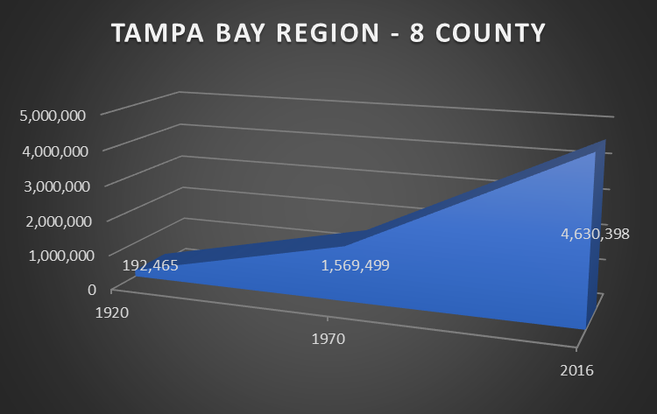
DEMAND: POPULATION GROWTH
Source: US Census

Slide 8
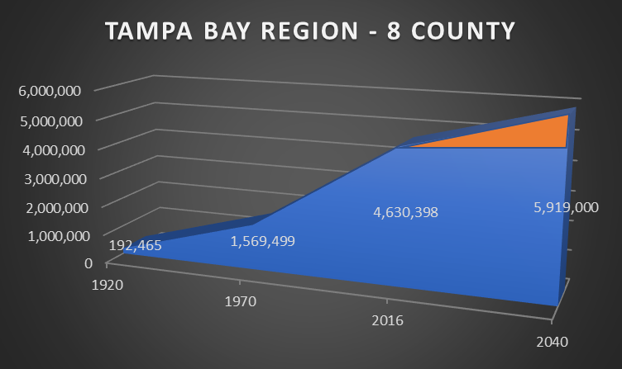
DEMAND: POPULATION GROWTH
Source: 2040 Population Estimates from Tampa Bay Regional Planning Model, 2016

Slide 9
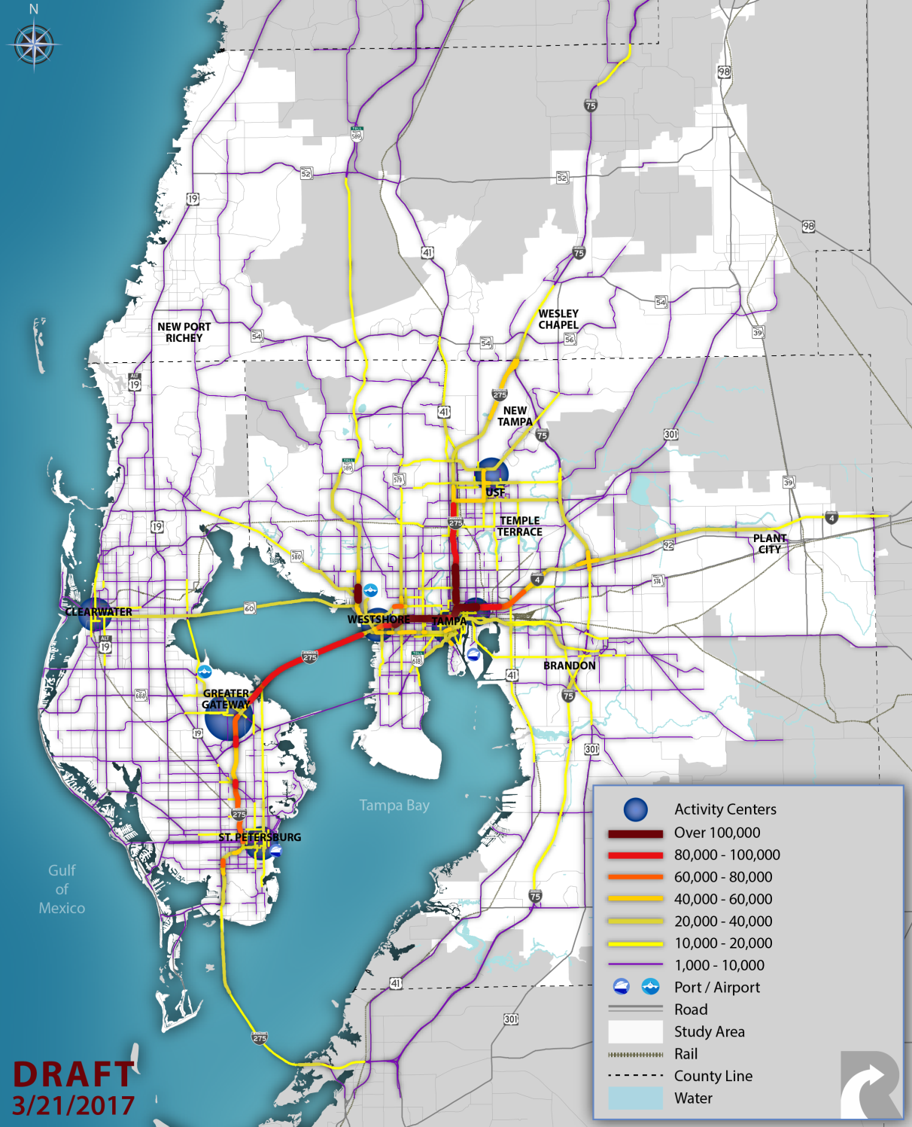
DESIGN: 2010 TRAVEL TO CENTERS
Daily Trips to Regional Activity Centers
Reflects Actual Travel Decisions

Slide 10
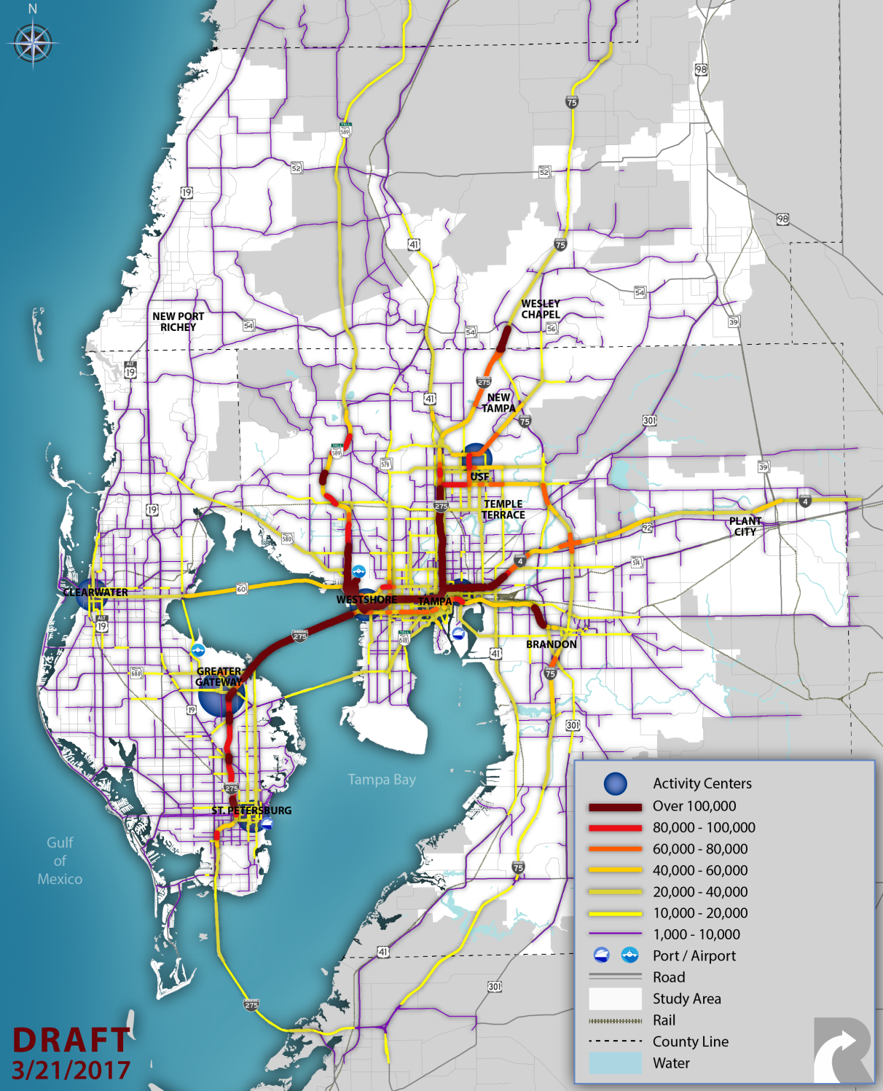
DESIGN: 2040 TRAVEL MARKET
Daily Trips to Regional Activity Centers
Reflects Actual Travel Decisions

Slide 11
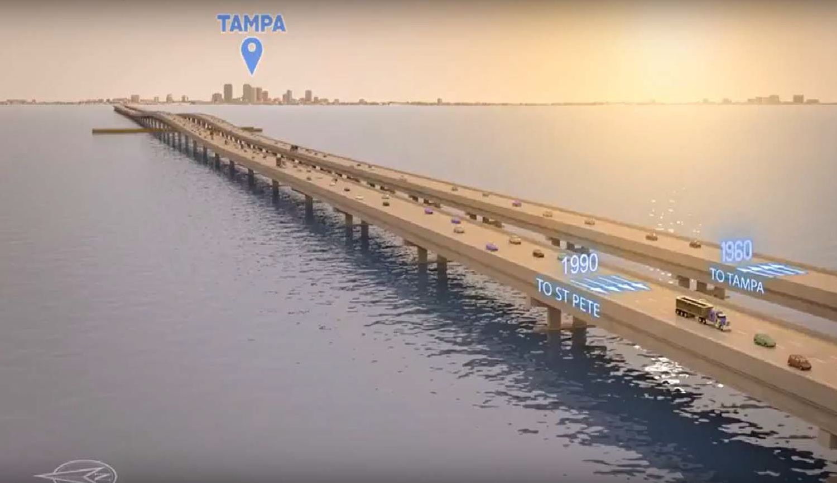
DESIGN: TAMPA TO ST. PETE
Southbound span built in 1990
Northbound span built in 1960

Slide 12
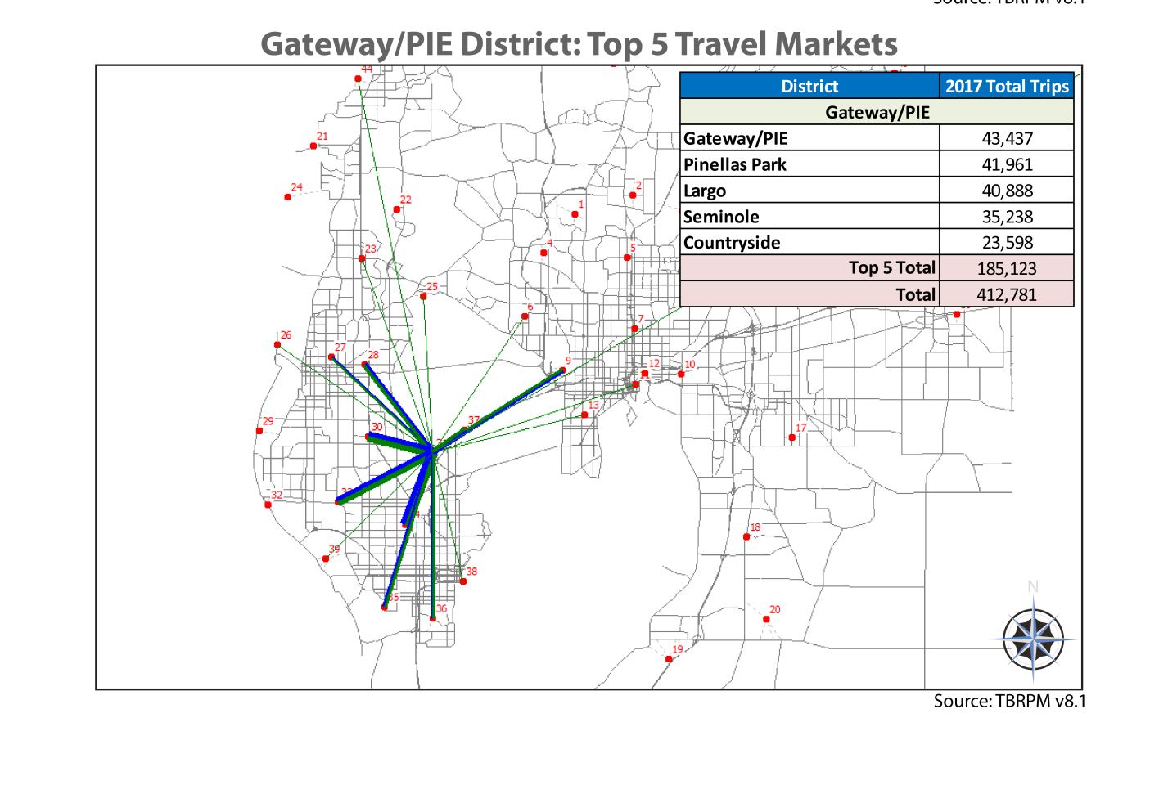
CHOICE: TOP TRAVEL MARKET: GATEWAY/PIE
Individual Travel Markets
Zone to Zone desire lines (center of Zones)
Illustration of individual zones relationship to other zones
Does not include all zonal relationships (only top 5)
Does not reflect actual travel decisions
Not assigned to transportation network

Slide 13
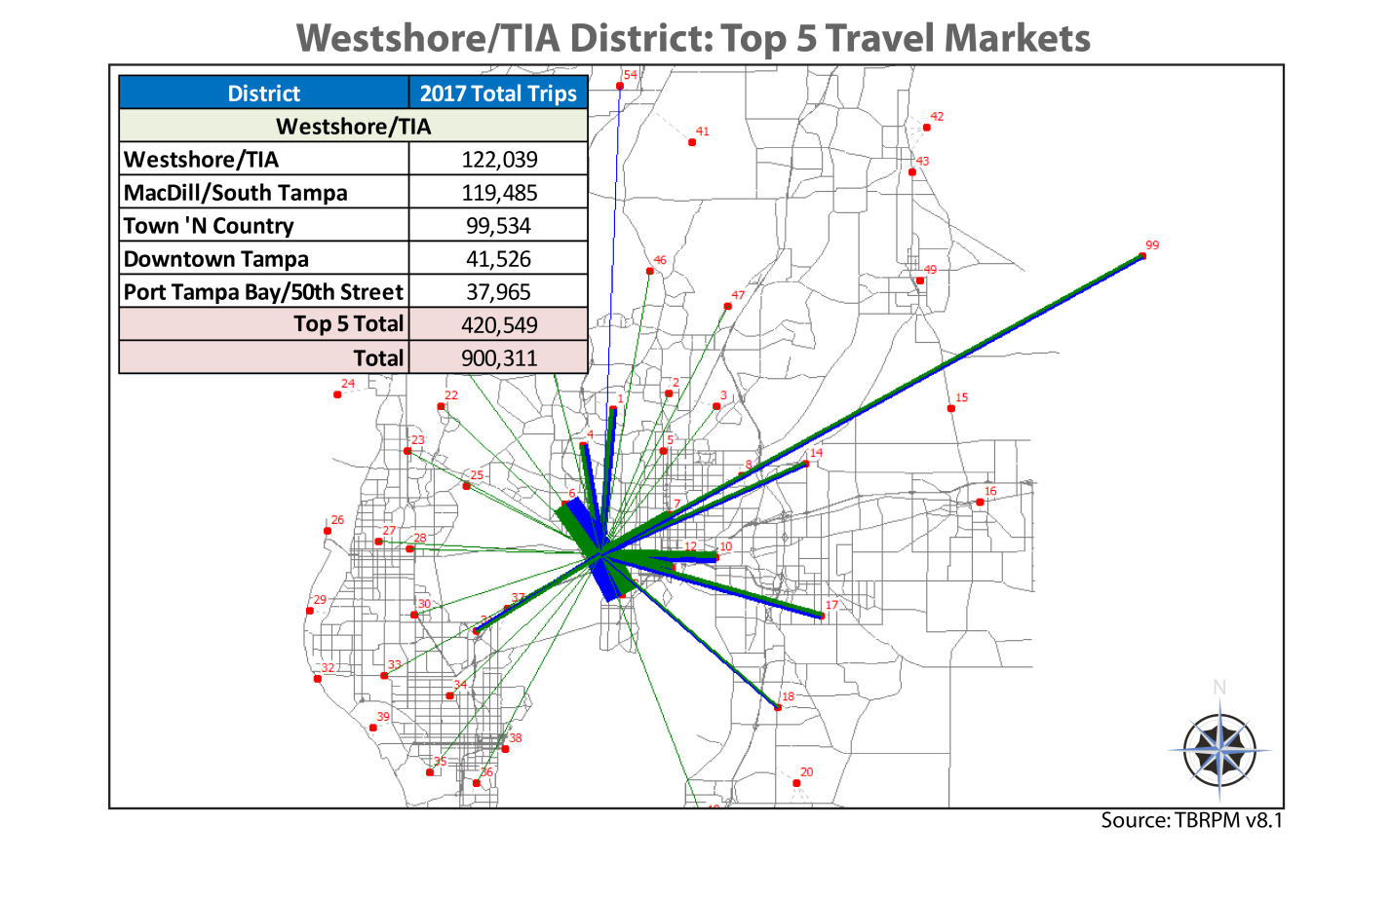
CHOICE: TOP TRAVEL MARKET: WESTSHORE/TIA
Individual Travel Markets
Zone to Zone desire lines (center of Zones)
Illustration of individual zones relationship to other zones
Does not include all zonal relationships (only top 5)
Does not reflect actual travel decisions
Not assigned to transportation network

Slide 14
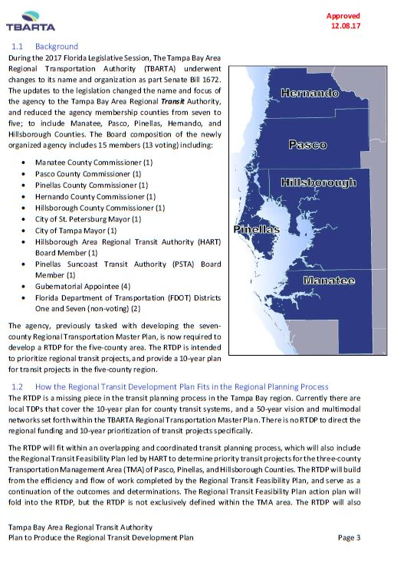
CONSENSUS: TBARTA REGIONAL TRANSIT DEVELOPMENT PLAN
Required to produce a Regional Transit Development Plan (TDP), to include regional priorities for transit projects and facilities, including:
Review and coordination with member comprehensive plans, programs and schedules for consistency
Major update every 5 years after adoption; minor updates annually
Plan and updates presented to governing bodies of member counties, TBARTA MPOs CCC, and legislative delegation 90 days after adoption

Slide 15
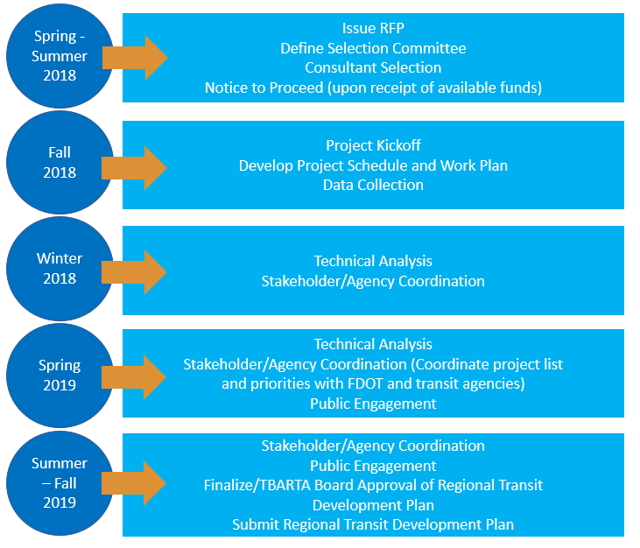
CONSENSUS: PLAN TO PRODUCE THE REGIONAL TDP
Notes:
A Regional Fare Collection Working Group was established in 2012 by the transit operators in the Tampa Bay area, to consider opportunities for regional consistency of fare collection as transit agencies upgrade and replace fareboxes, discuss regional fare collection policies, and consolidate management functions of their systems. The Working Group is working on a phased approach to implementing a seamless regional system, with consideration of advanced technology such as a Smart Card. A vendor was recently selected, and the project is expected to move into its first phase of implementation next year. CUTR is also spearheading a study to determine what upgrades each transit provider will need to make in order to participate, and how much it will cost.
TBARTA's One Bus Away app, (like Hillsborough's HART app) is getting closer to being ready. The One Bus Away app will tell anyone with a cell phone when (to the minute) the bus will be at the stop. TBARTA is investing $67,000 to develop a "PASS" similar to the Sun Pass
The TBARTA New Freedom planning project for Citrus and Hernando Counties aims to develop a plan for the mobility challenged population, seeking integration into the work force and full participation in society. The intent of the project was to identify viable solutions to overcome barriers facing mobility-impaired persons, particularly the disabled and elderly, within and between Hernando and Citrus Counties, as well as assist these counties with pursuing funding to implement effective strategies for the expansion, efficiency, and effectiveness of services.

Slide 16
CONSENSUS: PLAN TO PRODUCE THE REGIONAL TDP
Notes:
A Regional Fare Collection Working Group was established in 2012 by the transit operators in the Tampa Bay area, to consider opportunities for regional consistency of fare collection as transit agencies upgrade and replace fareboxes, discuss regional fare collection policies, and consolidate management functions of their systems. The Working Group is working on a phased approach to implementing a seamless regional system, with consideration of advanced technology such as a Smart Card. A vendor was recently selected, and the project is expected to move into its first phase of implementation next year. CUTR is also spearheading a study to determine what upgrades each transit provider will need to make in order to participate, and how much it will cost.
TBARTA's One Bus Away app, (like Hillsborough's HART app) is getting closer to being ready. The One Bus Away app will tell anyone with a cell phone when (to the minute) the bus will be at the stop. TBARTA is investing $67,000 to develop a "PASS" similar to the Sun Pass
The TBARTA New Freedom planning project for Citrus and Hernando Counties aims to develop a plan for the mobility challenged population, seeking integration into the work force and full participation in society. The intent of the project was to identify viable solutions to overcome barriers facing mobility-impaired persons, particularly the disabled and elderly, within and between Hernando and Citrus Counties, as well as assist these counties with pursuing funding to implement effective strategies for the expansion, efficiency, and effectiveness of services.

Slide 17
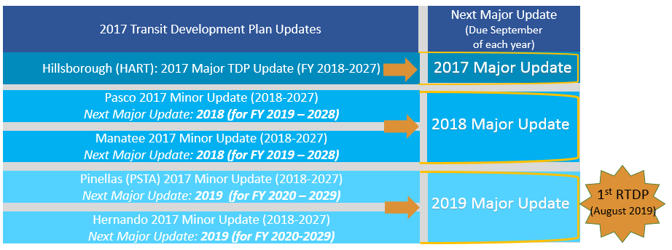
CONSENSUS: REGIONAL TDP DECISION MAKING PROCESS
Notes:
A Regional Fare Collection Working Group was established in 2012 by the transit operators in the Tampa Bay area, to consider opportunities for regional consistency of fare collection as transit agencies upgrade and replace fareboxes, discuss regional fare collection policies, and consolidate management functions of their systems. The Working Group is working on a phased approach to implementing a seamless regional system, with consideration of advanced technology such as a Smart Card. A vendor was recently selected, and the project is expected to move into its first phase of implementation next year. CUTR is also spearheading a study to determine what upgrades each transit provider will need to make in order to participate, and how much it will cost.
TBARTA's One Bus Away app, (like Hillsborough's HART app) is getting closer to being ready. The One Bus Away app will tell anyone with a cell phone when (to the minute) the bus will be at the stop. TBARTA is investing $67,000 to develop a "PASS" similar to the Sun Pass
The TBARTA New Freedom planning project for Citrus and Hernando Counties aims to develop a plan for the mobility challenged population, seeking integration into the work force and full participation in society. The intent of the project was to identify viable solutions to overcome barriers facing mobility-impaired persons, particularly the disabled and elderly, within and between Hernando and Citrus Counties, as well as assist these counties with pursuing funding to implement effective strategies for the expansion, efficiency, and effectiveness of services.

Slide 18
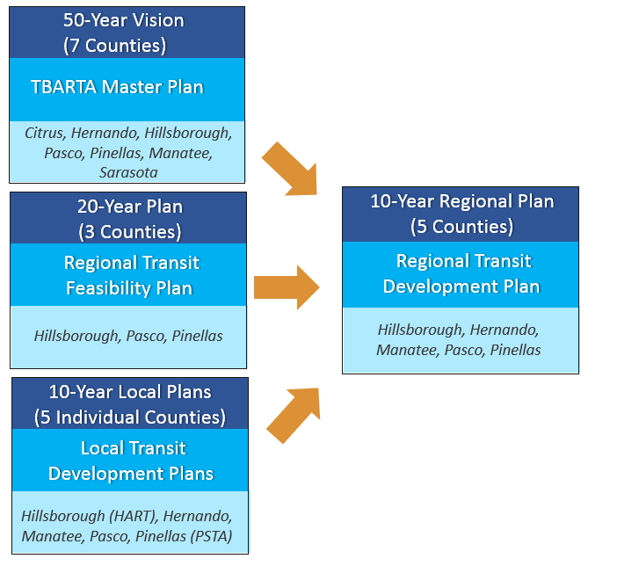
CONSENSUS: REGIONAL TDP COORDINATION
MPO Long Range Transportation Plans
Hillsborough, Pasco, Pinellas

Slide 19



TAMPA BAY IS UNIQUE
TAMPA BAY
CHARLOTTE
ATLANTA

Slide 20
NEXT STEPS
      Issue RFP to produce the Regional TDP
      Adopt the Regional Transit Feasibility Plan and implement catalyst project.
      Continue to engage the private sector in the delivery of transportation services
      Expand Vanpool program across the region

Slide 21
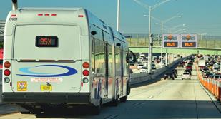

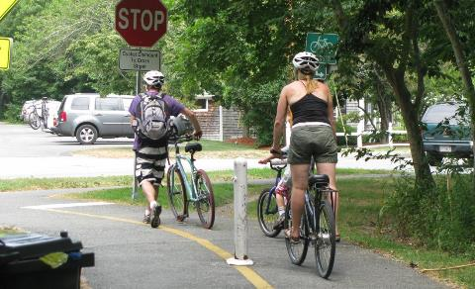

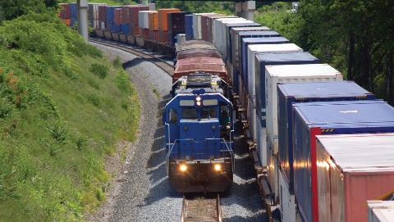
THANK YOU
www.pedbikeimages.org/Laura Sandt

